Slide 1
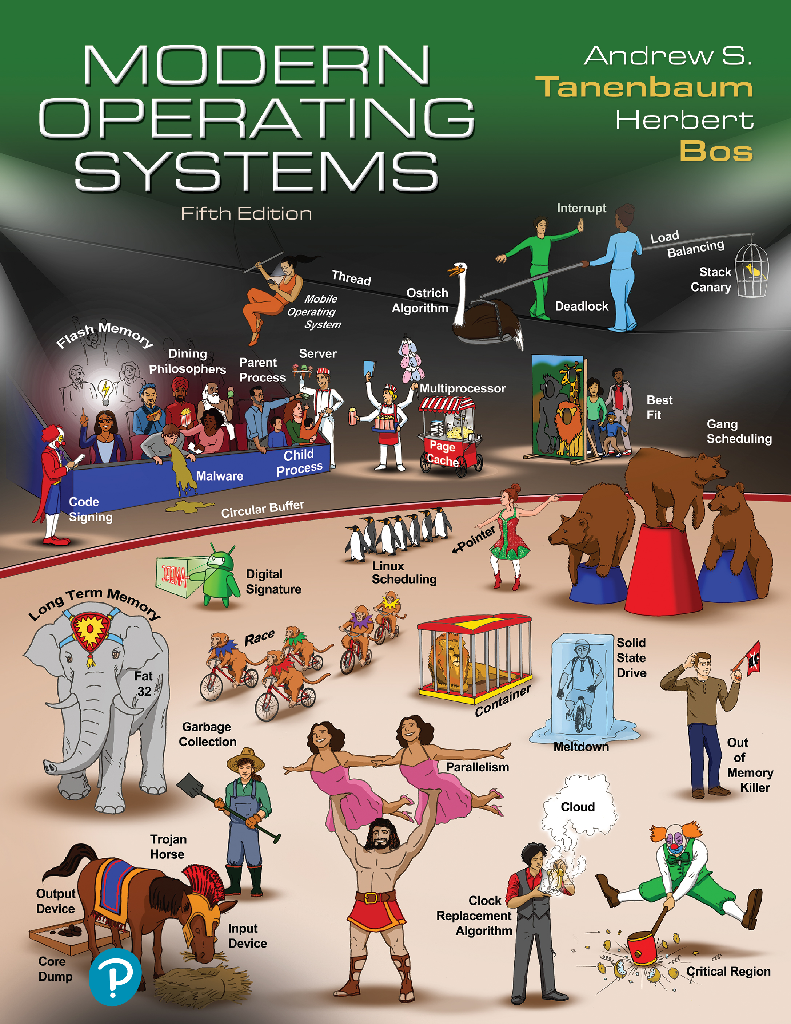

Modern Operating Systems
Fifth Edition
Chapter 1
Introduction
Copyright © 2023, 2014, 2008 Pearson Education, Inc. All Rights Reserved

Slide 2
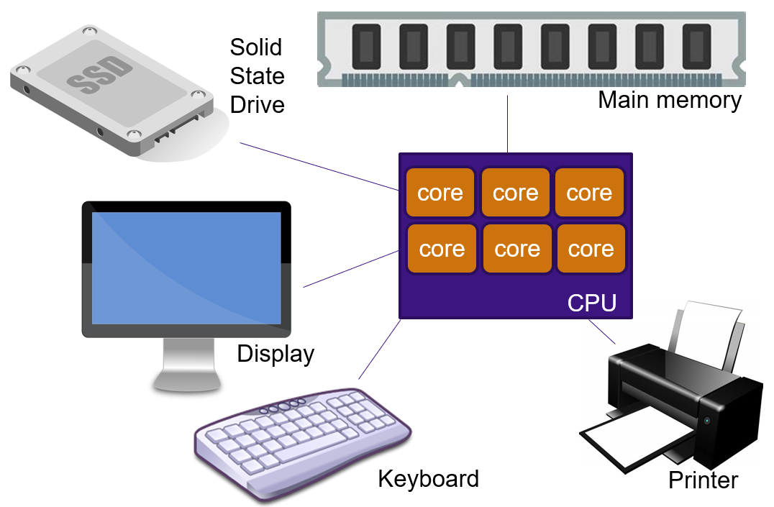
Components of a Modern Computer
One or more processors
Main memory
Disks or Flash drives
Printers
Keyboard
Mouse
Display
Network interfaces
I/O devices

Slide 3
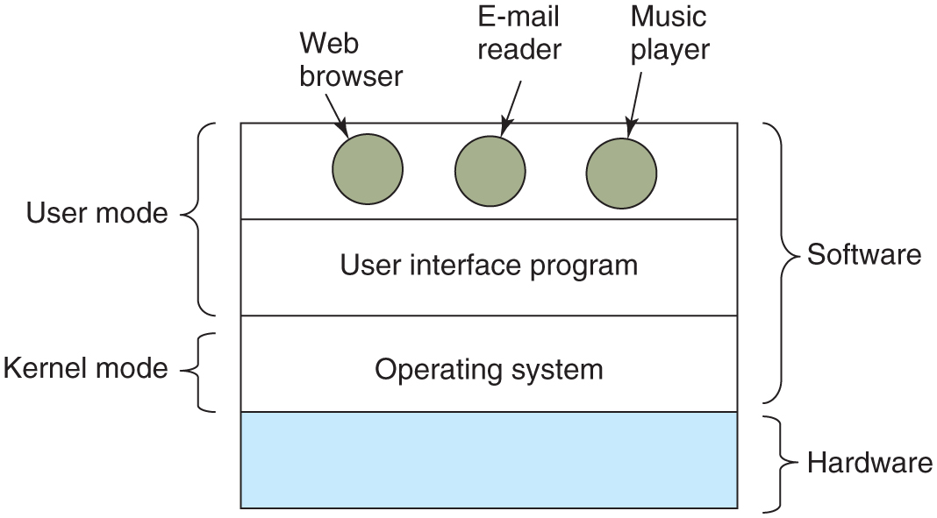
Components of a Modern Computer
Where the operating system fits in.

Slide 4
The Operating System as a Resource Manager
Top-down view
Provide abstractions to application programs
Bottom-up view
Manage pieces of complex system
Provide orderly, controlled allocation of resources

Slide 5
History of Operating Systems
The first generation (1945-55): Vacuum tubes
The second generation (1955-65): Transistors and batch systems
The third generation (1965-1980): I C s and multiprogramming
The fourth generation (1980-present): Personal computers
The fifth generation (1990-present): Mobile computers

Slide 6
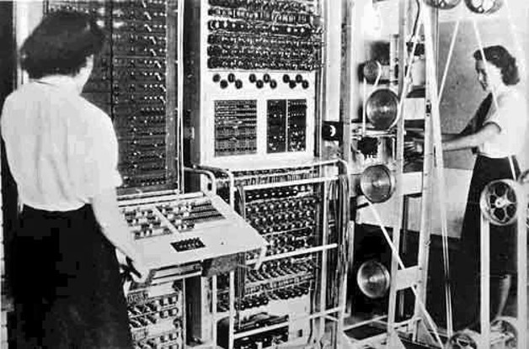
First Generation: Vacuum tubes
Annotated photographs of the COLOSSUS electronic digital computer/Kew/National Archives and Records Administration (N A R A) [F O 850/234]
The Colossus Mark 2 computer: Cryptanalysis of the Lorenz Cipher

Slide 7
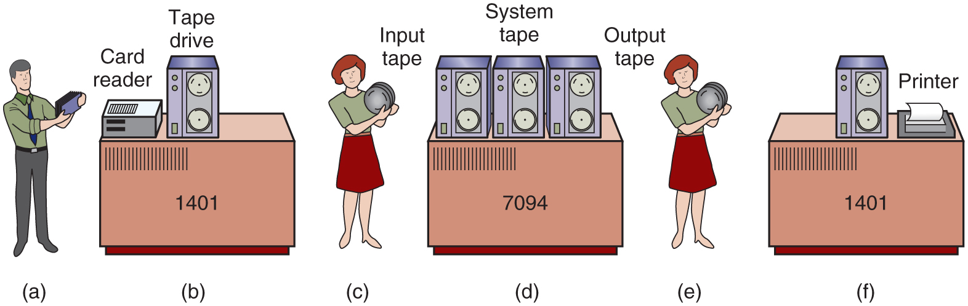
Second Generation: Transistors and Batch Systems
An early batch system. (a) Programmers bring cards to 1401. (b) 1401 reads batch of jobs onto tape. (c) Operator carries input tape to 7094. (d) 7094 does computing. (e) Operator carries output tape to 1401. (f) 1401 prints output.

Slide 8
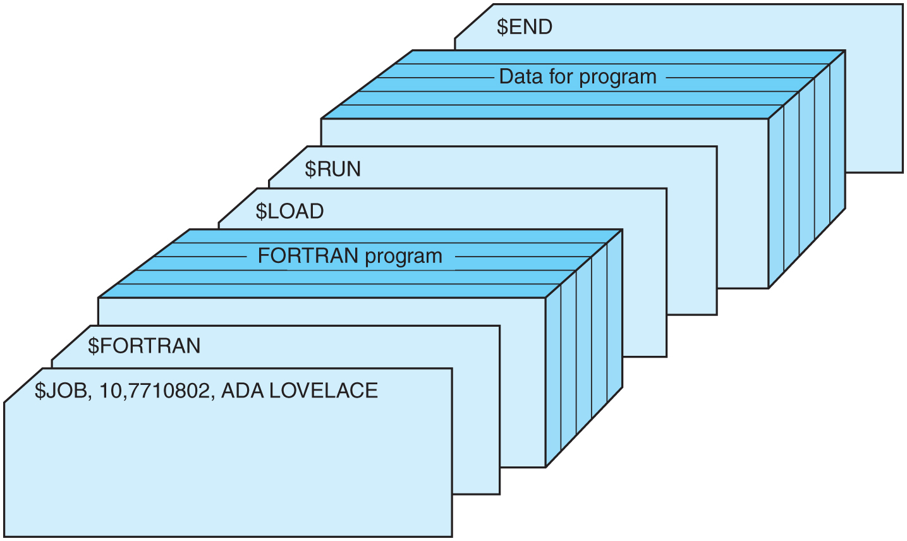
Second Generation: Transistors and Batch Systems
Structure of a typical F M S job.

Slide 9
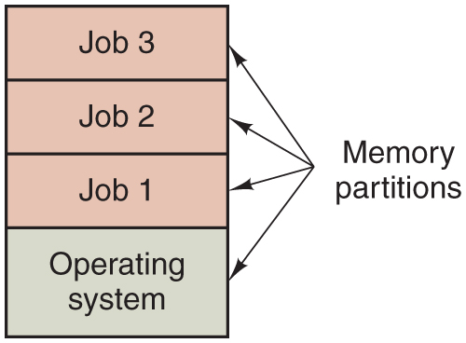
Third Generation: I C s and Multiprogramming
A multiprogramming system with three jobs in memory.

Slide 10
U N I X – a Simpler Operating System
Courtesy of the Computer History Museum
/*
* You are not expected to understand this.
*/
Comment by Ken Thompson in the source code of UNIXv6, 1975. A.k.a the most famous comment ever. Interestingly, the code to which it pertained contained a bug, so perhaps the authors did not understand it either. :)

Slide 11
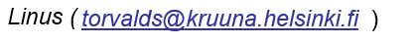
MINIX (1980s)
“Hello everybody out there using minix -
I'm doing a (free) operating system (just a hobby, won't be big and
professional like gnu) for 386(486) A T clones. This has been brewing
since april, and is starting to get ready. I'd like any feedback on
things people like/dislike in minix, as my O S resembles it somewhat
(same physical layout of the file-system (due to practical reasons)
among other things).
I've currently ported bash(1.08) and g c c(1.40), and things seem to work.
This implies that I'll get something practical within a few months, and
I'd like to know what features most people would want. Any suggestions
are welcome, but I won't promise I'll implement them :-)
P S. Yes - it's free of any minix code, and it has a multi-threaded fs.
It is NOT portable (uses 386 task switching etc), and it probably never will support anything other than A T-hard disks, as that's all I have :-(”.

Slide 12
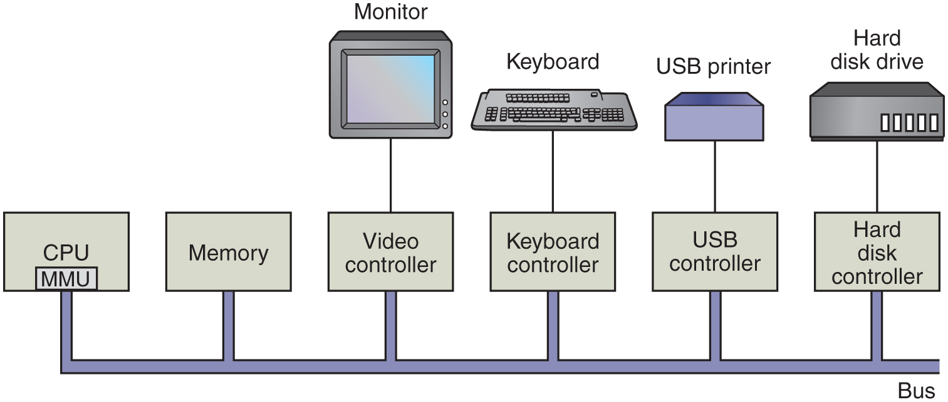
Hardware - Processors
Some of the components of a simple personal computer.

Slide 13
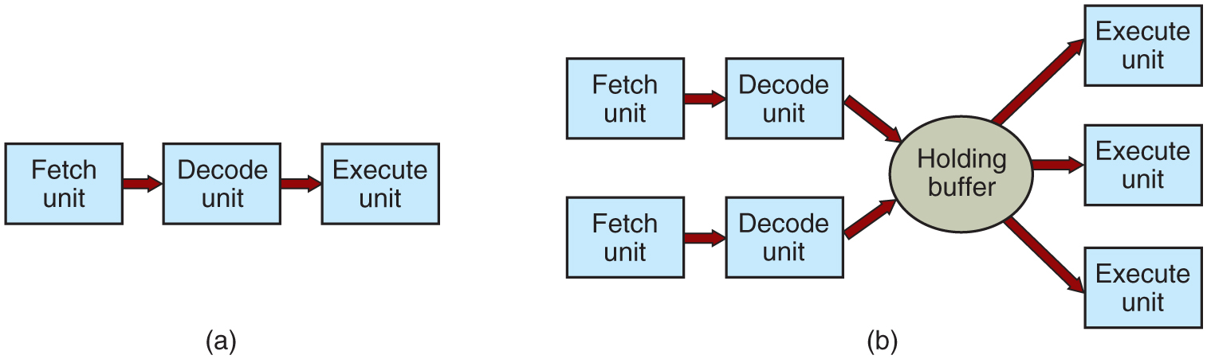
Hardware - Processors
a) A three-stage pipeline. (b) A superscalar C P U.

Slide 14
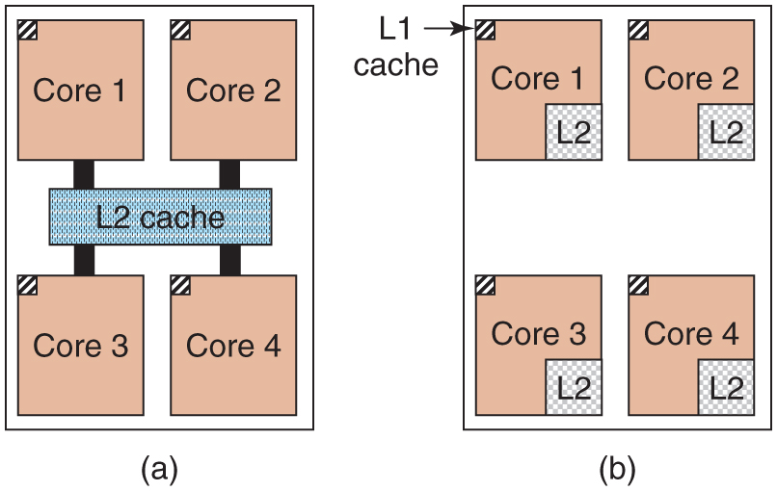
Hardware - Memory
(a) A quad-core chip with a shared L2 cache. (b) A quad-core chip with separate L2 caches.

Slide 15
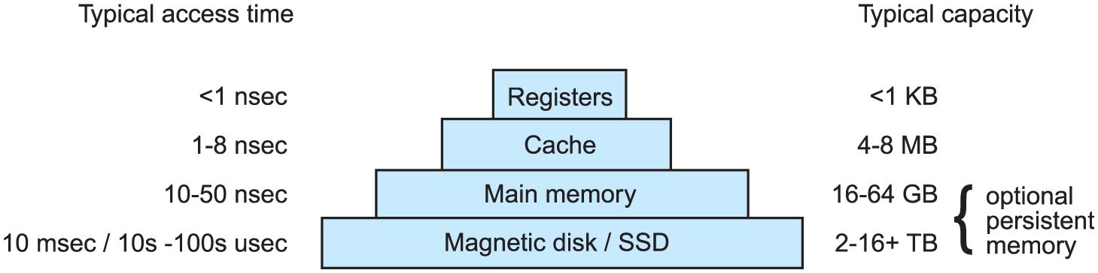
Hardware - Memory
A typical memory hierarchy. The numbers are very rough approximations.

Slide 16
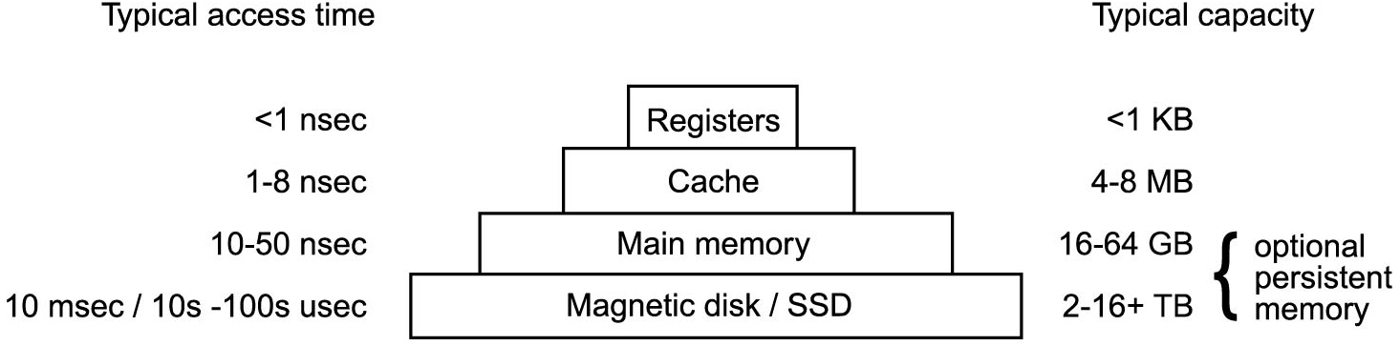
Hardware - Memory
Caching system issues:
When to put a new item into the cache.
Which cache line to put the new item in.
Which item to remove from the cache when a slot is needed.
Where to put a newly evicted item in the larger memory.

Slide 17
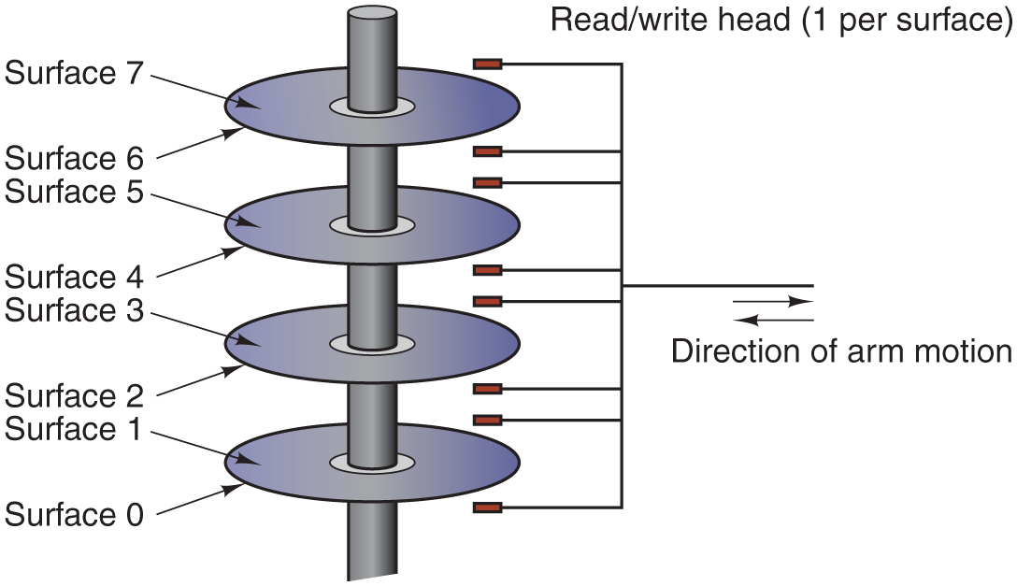
Nonvolatile Storage
Structure of a disk drive.

Slide 18
Solid State Drives (S S D)
Often (incorrectly) referred to as disk also. No moving parts, data in electronic (flash) memory. Much faster than magnetic disks.

Slide 19
I/O Devices
Many types of I/O devices.
Typically consist of 2 parts:
Controller
Chips that control device, receive commands from O S (e.g., to read data) Example: S A T A disk controller
Device itself
Generally simple interface (so S A T A controller can handle any S A T A disk)
Device driver: O S component that talks to controller
One for each type of device controller

Slide 20
I/O Devices
Device driver communicates with controller via registers
Example: disk controller may have registers for
disk address,
memory address
sector count
direction (read or write)
Device registers are either accessed using special instructions (e.g., IN/OUT). or mapped in the O S’ address space (the addresses it can use).
The collection of device registers forms the I/O Port Space

Slide 21
I/O Devices
To perform I/O:
Process executes system call
Kernel makes a call to driver
Driver starts I/O
Either polls device to see if it is done (busy waiting)
or asks device generate an interrupt when it is done more advanced: make use of special hardware – D M A

Slide 22
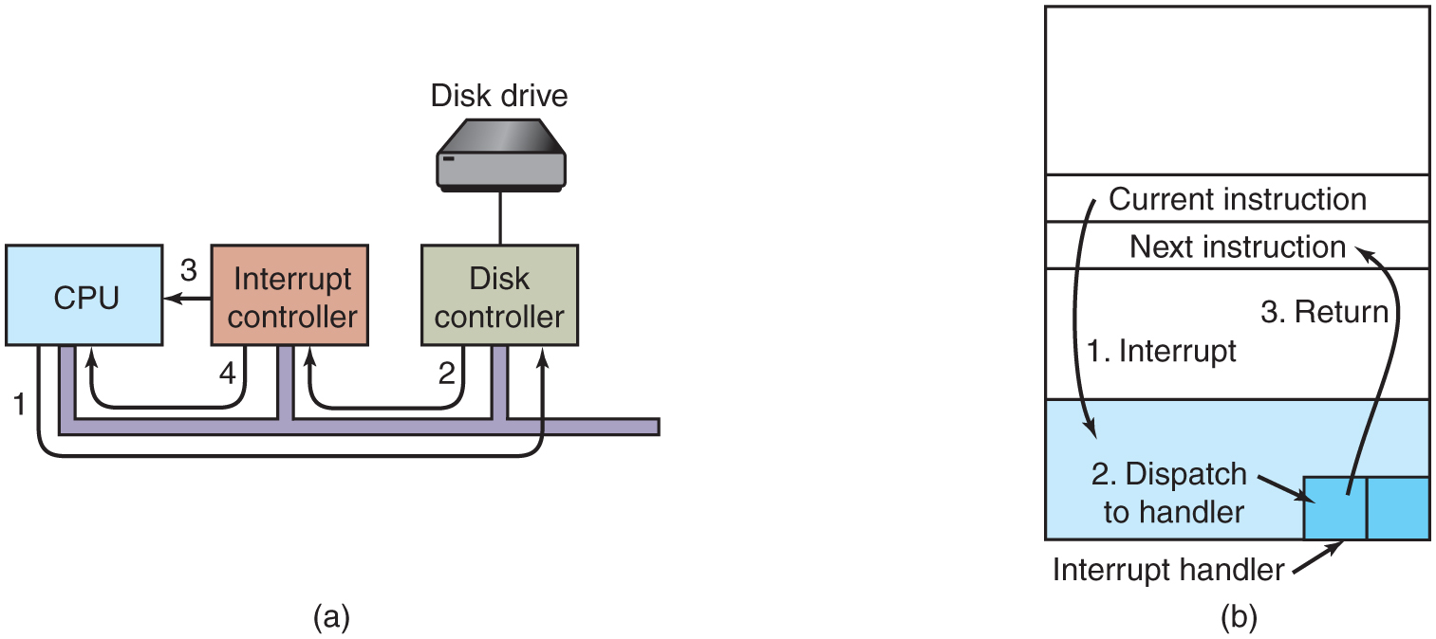
I/O Devices
(a) The steps in starting an I/O device and getting an interrupt. (b) Interrupt processing involves taking the interrupt, running the interrupt handler, and returning to the user program.

Slide 23
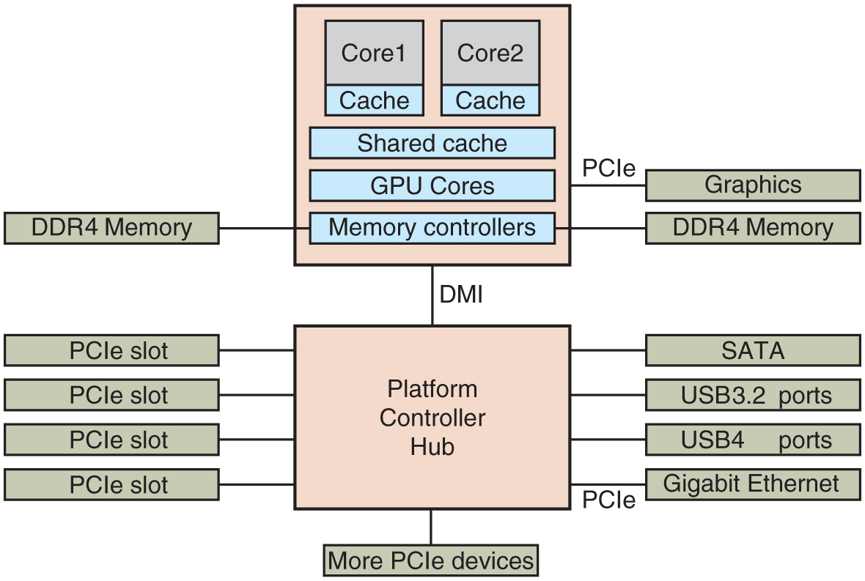
Busses
The structure of a large x 8 6 system: many buses (e.g., cache, memory, P C I e, U S B, S A T A, and D M I)

Slide 24
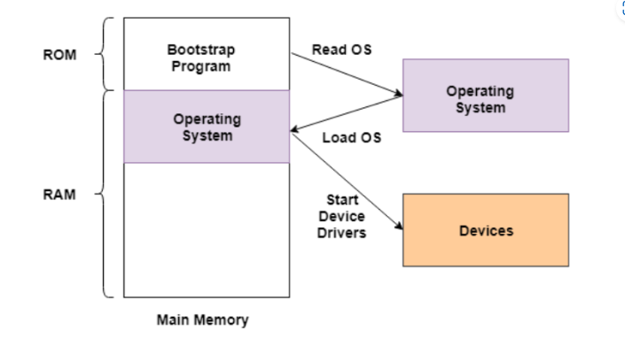
Computer Startup
Flash memory on motherboard contains firmware (a.k.a. B I O S)
After pressing power button, C P U executes B I O S which
Initializes R A M and other resources
Scans P C I/P C I e buses and initializes devices
Sets up the runtime firmware for critical services (e.g., low-level I/O) to be used by the system after booting
B I O S looks for location of partition table on second sector of boot device
Contains locations of other partitions

Slide 25
Operating System Types
Mainframe Operating Systems
Server Operating Systems
Personal Computer Operating Systems
Smartphone and Handheld Computer Operating Systems
The Internet of Things (I O T) and Embedded Operating Systems
Real-Time Operating Systems
Smart Card Operating Systems

Slide 26
What is an Operating System
Extended Machine
Extending the hardware functionality
Abstraction over hardware
Hiding details from the programmer
Resource Manager
Protects simultaneous/unsafe usage of resources
Fair sharing of resources
Resource accounting/limiting

Slide 27
Operating System Concepts
O S offers functionality through system calls
Groups of system calls implement services
File System Service
Process Management Service
Processes are user-level abstractions to execute a program on behalf of a user
Each process has its own address space
Data involved in this processing is retrieved from/stored in files
Files persist over processes

Slide 28
Processes
Key concept in all operating systems
Definition: a program in execution
Process is associated with an address space
Also associated with set of resources (registers, open files, alarms, etc.)
Process can be thought of as a container
Holds all information needed to run program

Slide 29
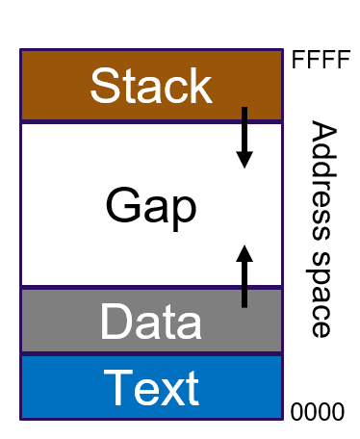
Processes
Layout affected by:
Architecture
O S
Program
Very basic layout:
Stack: Active call data
Data: Program variables
Text: Program code
Try it:
Linux : readelf –S <program name>
MAC : otool –l <program name>

Slide 30
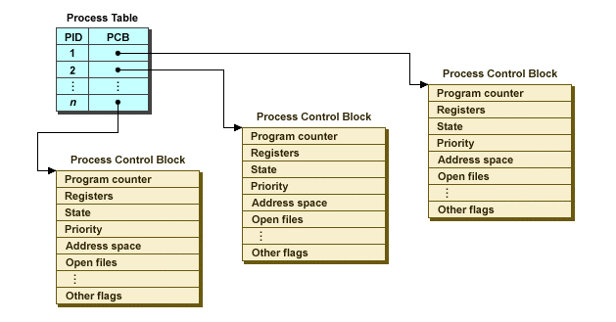
Processes
Information about process is kept in the O S’ process table
Process Management
Operations such as creating, terminating, pausing and resuming a processes
One process can create another process
Known as a child process
Creates a hierarchy (or “tree”) of processes

Slide 31
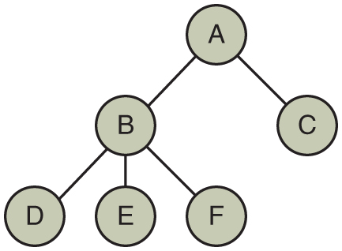
Processes
A process tree. Process A created two child processes, B and C. Process B created three child processes, D, E, and F.
Processes are “owned” by a user, identified by a U I D.
Every process typically has the U I D of the user who started it
On U N I X, a child process has the same U I D as its parent process
Users can be members of groups, identified by a G U I D
Try it:
Linux : pstree
MAC : Applications > Utilities > Activity Monitor or type “top”

Slide 32
Files
File: abstraction of (possibly) real storage device (e.g., disk)
You can read and write data from/to file by providing a position and an amount of data to transfer
Files are maintained in directories
A directory keeps an identifier for each file it contains
A directory is a file by itself
The U N I X philosophy: “Everything is a file”.

Slide 33
Files
Directories and files form a hierarchy:
Hierarchy starts at root directory:
/
Files can be accessed through absolute paths:
/home/ast/todo-list
… or relative paths starting from the current working directory:
../courses/slides1.pdf
Other filesystems can be mounted into the root:
/mnt/windows
Filesystems mounting on Windows?

Slide 34
Files
Files are “protected” by three bit tuples for owner, group and other users
Tuples contain a (r)ead, (w)rite and an e(x)ecute bit (but more bits are available)
Example:
-rwxr-x--x myuser my group 14492 Dec 4 18:04 my file
Owner is allowed to execute, modify, read the file
Group is allowed to read and execute the file
Other users are only allowed to execute the file
x bit for directories?

Slide 35
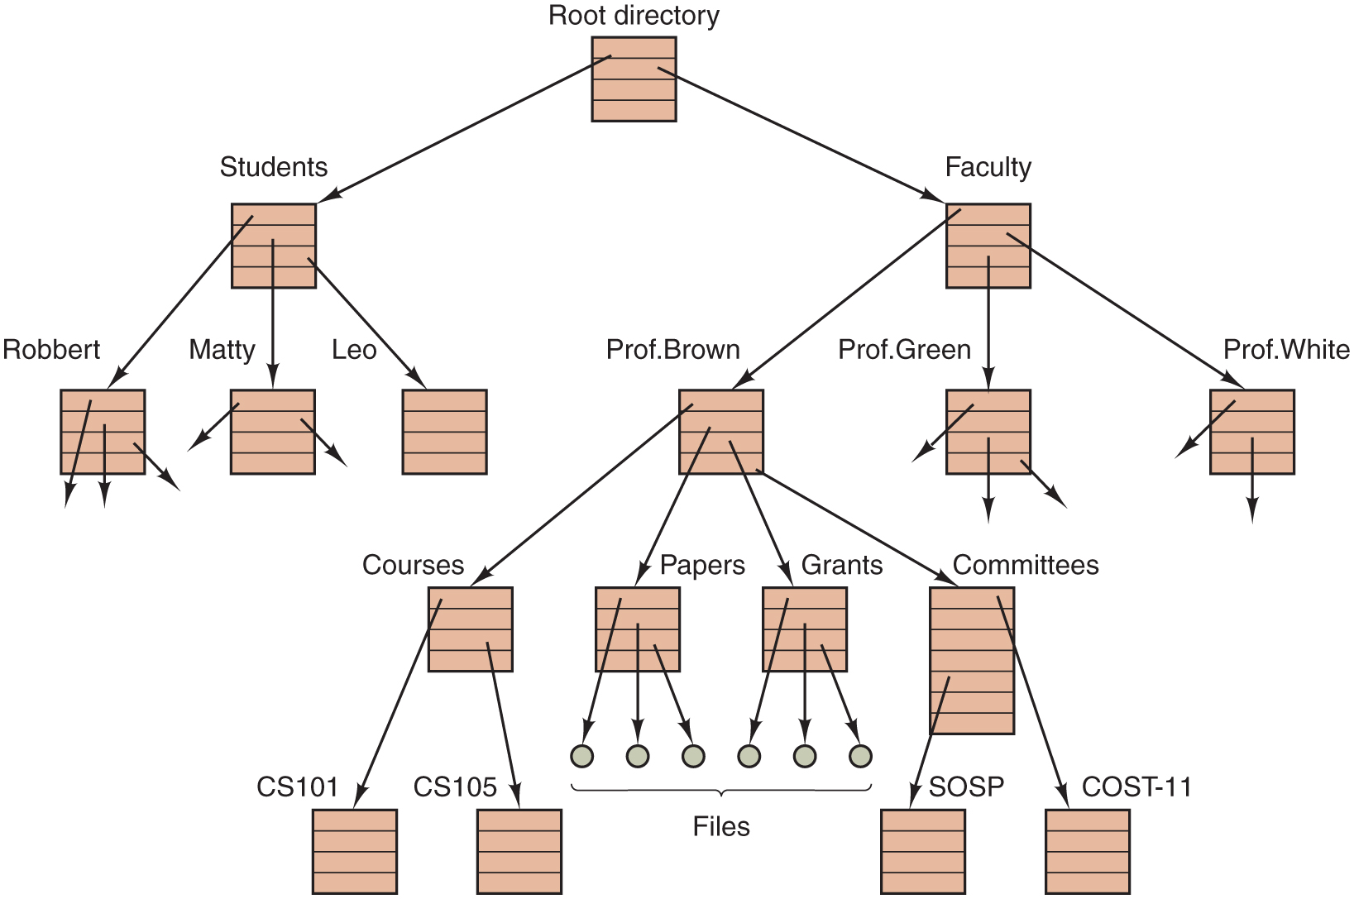
Files
A file system for a university department.

Slide 36
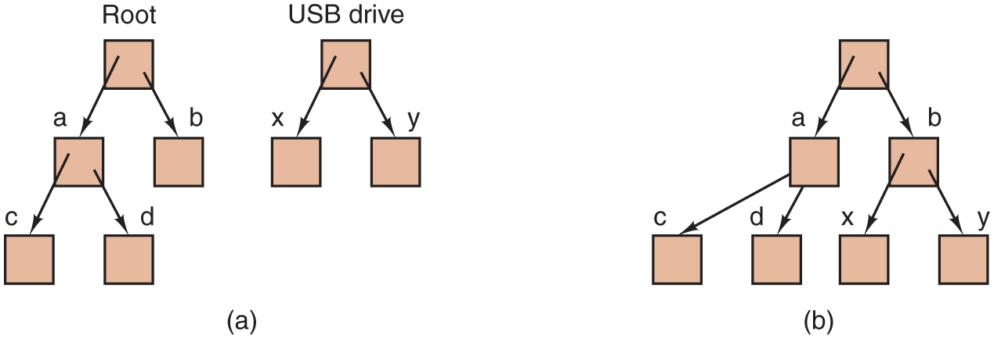
File System Mounting
(a) Before mounting, the files on the U S B drive are not accessible. (b) After mounting, they are part of the file hierarchy.

Slide 37
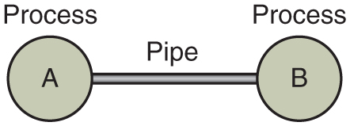
Files (Pipes)
Two processes connected by a pipe.
Pipes: pseudo files allowing for processes to communicate over a F I F O channel
Has to be set up in advance
Looks like a “normal” file to read and write from/to running processes

Slide 38
System Calls
System calls are the interface the O S offers to applications to request services
Problem:
System call mechanism is highly operating system and hardware specific
The need for efficiency exacerbates this problem
Solution:
Encapsulate system calls in the C library (libc)
Typically exports 1 library call for each system call
U N I X libc based on the C P O S I X library
Note that many U N I X C libraries exist…

Slide 39
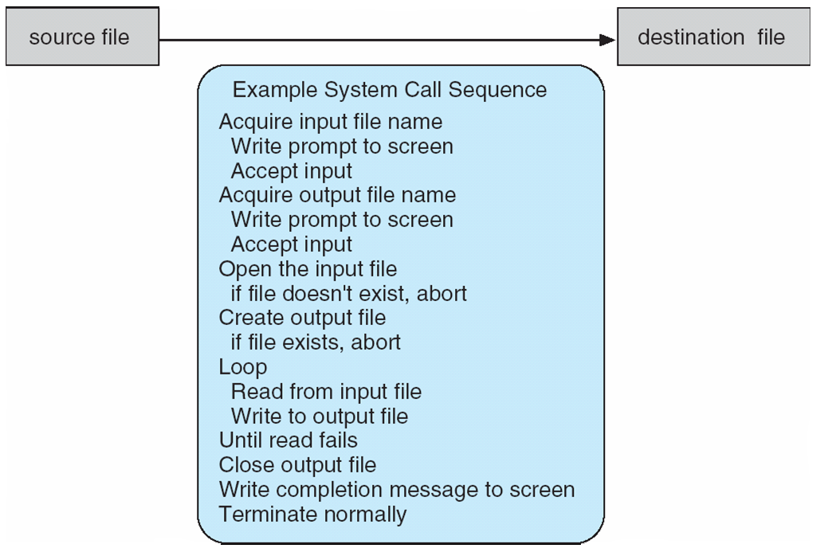
System Calls
System call sequence to copy the contents of one file to another file

Slide 40
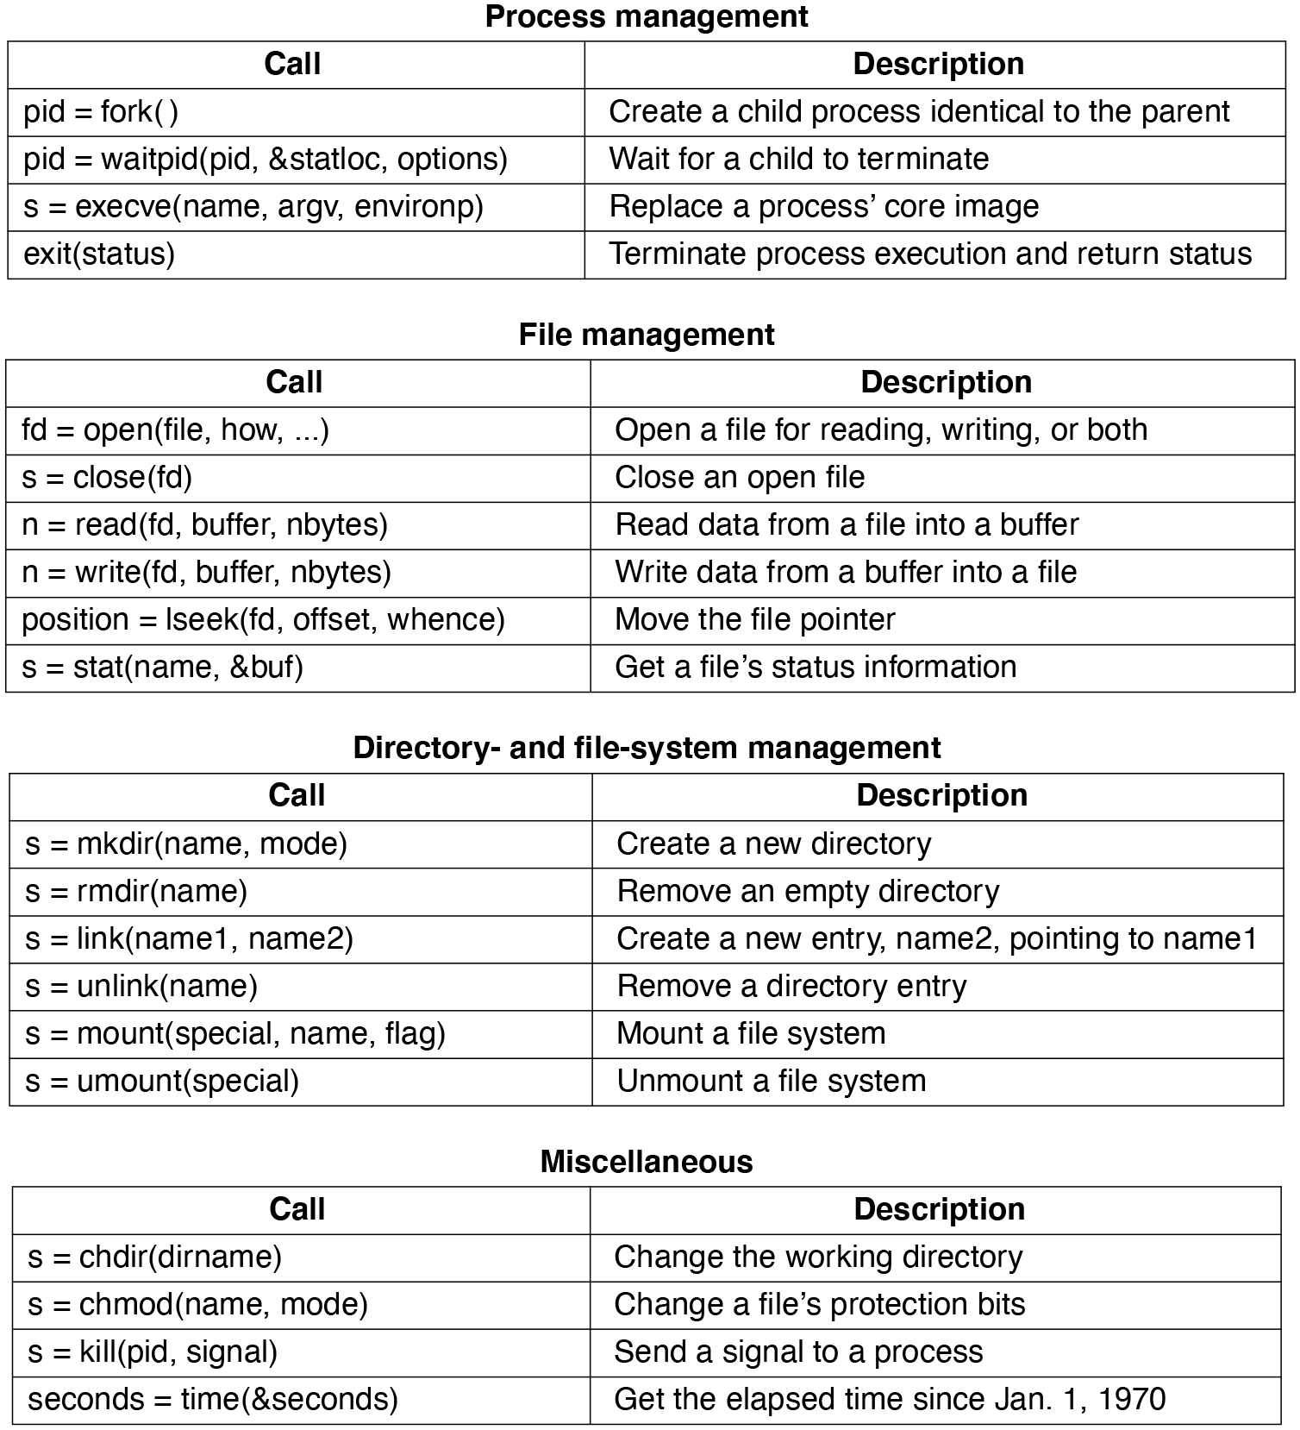
System Calls
Some of the major POSIX system calls. The return code s is −1 if an error has occurred. The return codes are as follows: pid is a process id, fd is a file descriptor, n is a byte count, position is an offset within the file, and seconds is the elapsed time. The parameters are explained in the text.

Slide 41
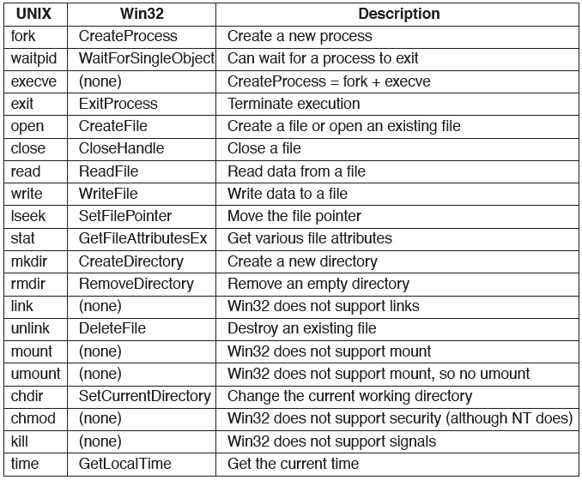
Windows System Call API
The Win32 A P I calls that roughly correspond to the UNIX calls of Fig. 1.18. It is worth emphasizing that Windows has a very large number of other system calls, most of which do not correspond to anything in UNIX.

Slide 42
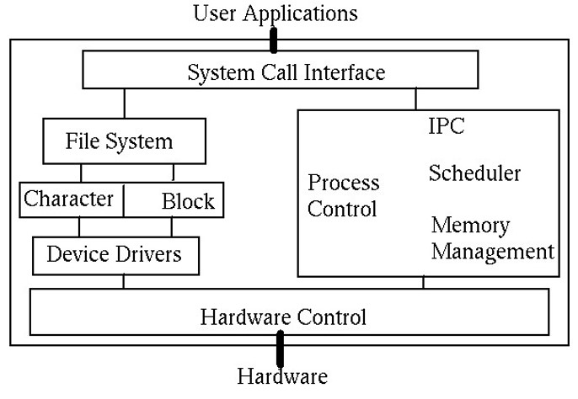
O S Structure: Monolithic
Typical U N I X structure

Slide 43
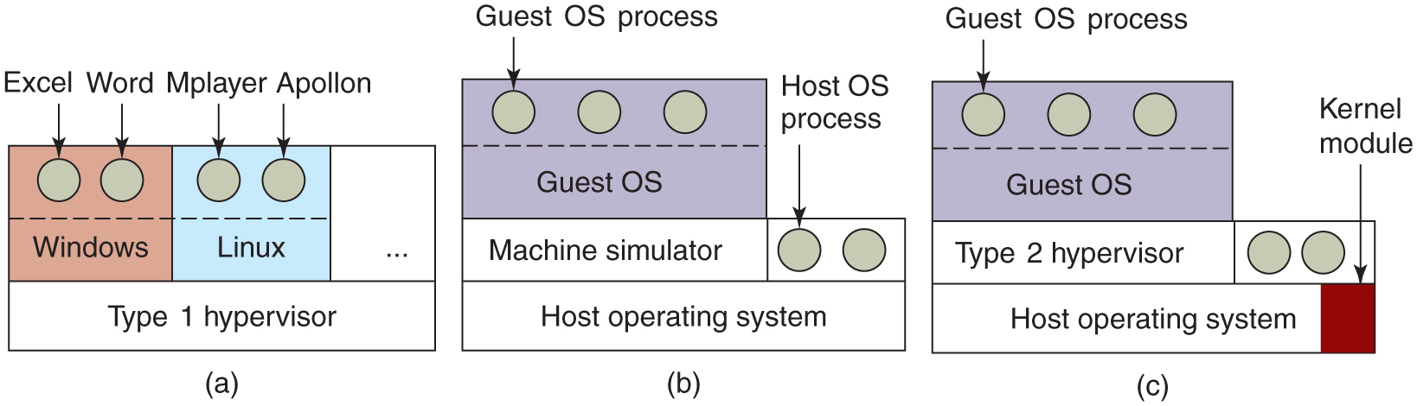
O S structure: Virtualization
Virtual machine monitor (V M M) or Hypervisor emulates hardware
Type 1: V M M runs on bare metal (e.g., Xen)
Type 2: V M M hosted in the O S (e.g., Q E M U)
Hybrid: V M M inside the O S (e.g., K V M)
(a) A type 1 hypervisor. (b) A pure type 2 hypervisor. (c) A practical type 2 hypervisor

Slide 44
Containers
Containers can run multiple instances of an O S on a single machine
Each container shares the host O S kernel and the binaries and libraries
Container does not contain full O S and therefore can be lightweight
Downsides to containers
Cannot run a container with a completely different OS than the host
Unlike with virtual machines no strict resource partitioning
Containers are process-level isolated
If a container alters the stability of the underlying kernel this may affect other containers

Slide 45
The World According to C
C was created by Dennis Ritchie in 1972 to develop U N I X programs
Some of the U N I X roots still visible
“Everything is a file”
UNIX/Linux – Everything is a file
Sockets
Devices
Hard drives
Printers
Pipes

Slide 46
The World According to C
What do we have to do to print “Hello World” on the console (Standard output)?
printf(char *str, …);
#include <stdio.h> int main(int argc, char **argv) { printf("Hello World!\n"); return 0; }

Slide 47
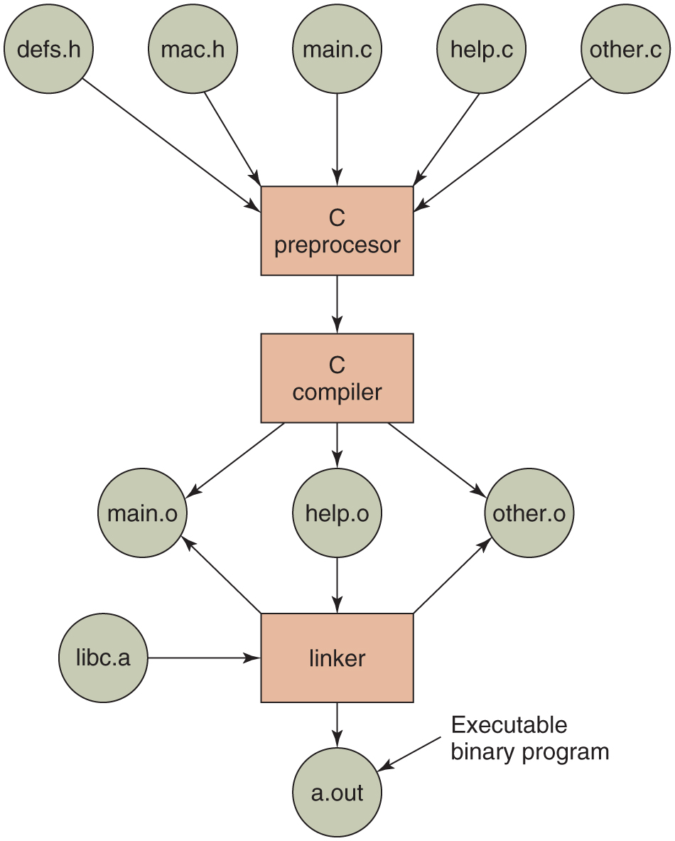
Build Process
The process of compiling C and header files to make an executable.

Slide 48
Hello World Example
What do we have to do to print “Hello World” on the console (Standard output)?
printf(char *str, …);
int write(int fd, char *buf, size_t len);

Slide 49
Recall: Everything Is a File!
Descriptive Name | Short Name | File Number | Description
Standard In | stdin | 0 | Input from the keyboard
Standard Out | stdout | 1 | Output to the console
Standard Error | stderr | 2 | Error output to the console
Default every process starts with 3 “files” opened

Slide 50
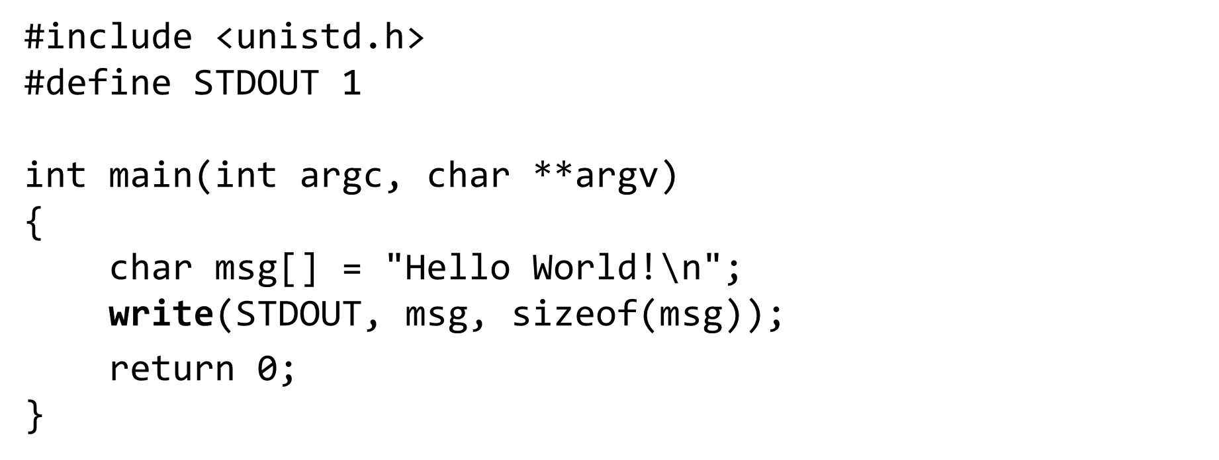
Hello World Example

Slide 51
Hello World Example
What do we have to do to print “Hello World” on the console (Standard output)?
printf(char *str, …);
int write(int fd, char *buf, size_t len);
int syscall(int number, ...);

Slide 52
Hello World Example
#define _G N U_SOURCE #include <sys/syscall.h> #define STDOUT 1
int main(int argc, char **argv) { char msg[] = "Hello World!\n";
int nr = SYS_write; syscall(nr, STDOUT, msg, sizeof(msg)); return 0; }

Slide 53
Standard C Library
Libc provides useful wrappers around syscalls
E.g., write, read, exit
Need to call the syscall or int 0x80 instruction
Done in assembly (inline, or separate object)
syscall(int nr, …)

Slide 54
Process Management System Calls
Consider a minimal shell:
Waits for user to type in a command
Starts a process to execute the command
Waits until the process has finished
(fork, wait, execv)

Slide 55
Process Creation
pid_t fork()
Duplicates the current process
Returns child pid in caller (parent)
Returns 0 in new (child) process
pid_t wait(int *wstatus)
Waits for child processes to change state
Writes status to wstatus
E.g., due to exit or signal

Slide 56
Process Creation (fork, wait)
void main(void) { int pid, child_status; if (fork() == 0) {
do_something_in_child();
} else {
wait(&child_status); // Wait for child
} }

Slide 57
Process Creation (execv)
int execv(const char *path, char *constargv[ ]);
Loads a new binary (path) in the current process, removing all other memory mappings.
constargv contains the program arguments
Last argument is NULL
E.g., constargv = {“/bin/ls”, “-a”, NULL}
Different exec(v)(p) variants (check man pages)

Slide 58
Process Creation (fork, wait, execv)
void main(void) { int pid, child_status;
char *args[] = {“/bin/ls”, “-l”, NULL}; if (fork() == 0) { // fork creates child process
execv(args[0], args); // in child: load+execute program
} else {
wait(&child_status); // Wait for child
} }

Slide 59
Minimal Shell
while (1) { char cmd[256], *args[256]; int status; pid_t pid;
read_command(cmd, args); /* reads command and arguments from command line */ pid = fork(); if (pid == 0) { execv(cmd, args); exit(1); } else { wait(&status); } }

Slide 60
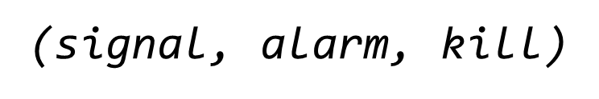
How to Exit Programs?
Ctrl+C, but how does this work??
Answer: signals
Processes sometimes need to be interrupted during their execution
A signal is sent to the process that needs to be interrupted
Interrupted process can catch the signal by installing a signal handler
What happens when a terminal user hits C T R L+C or C T R L+Z

Slide 61
Signals
sighandler_t signal(int signum, sighandler_t handler)
Registers a signal handler for signal signum
unsigned int alarm(unsigned int seconds)
Deliver S I G A L R M in specified number of seconds
int kill(pid_t pid, int sig)
Deliver signal sig to process pid

Slide 62
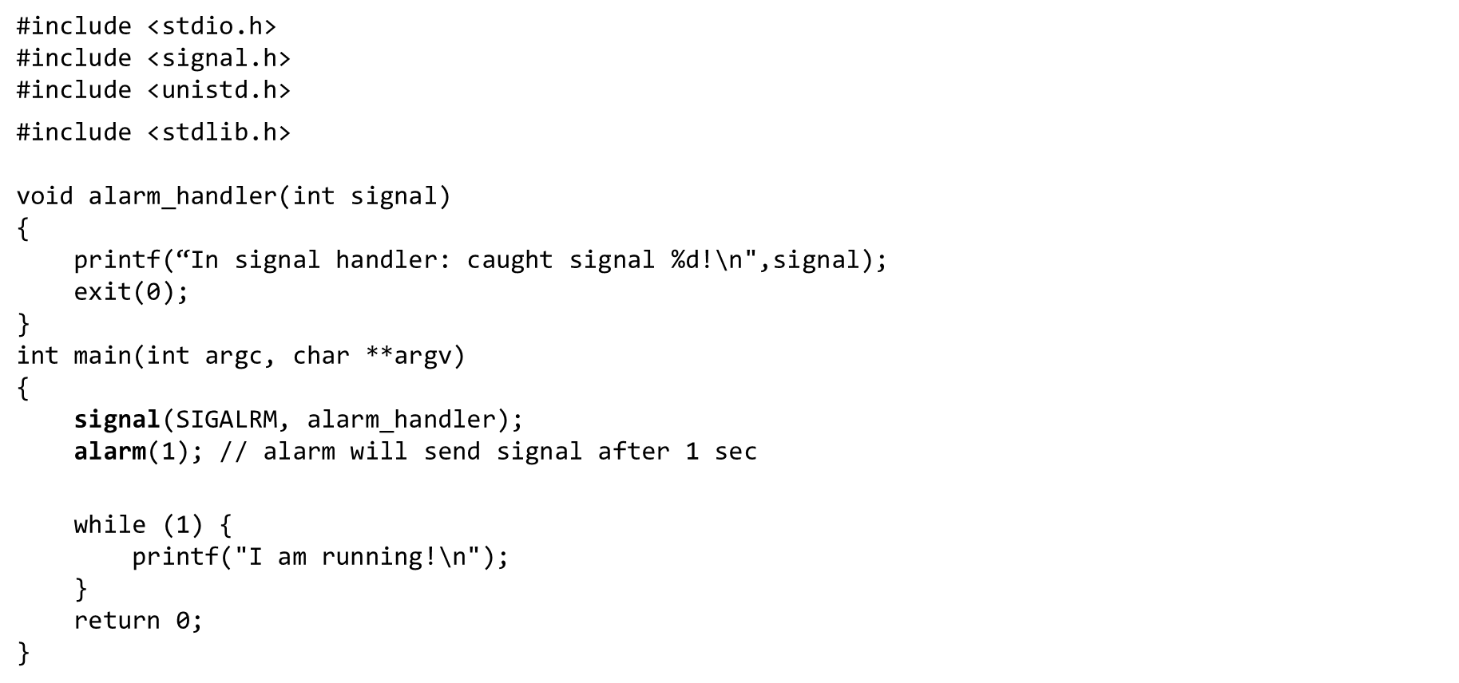
Alarm Example

Slide 63
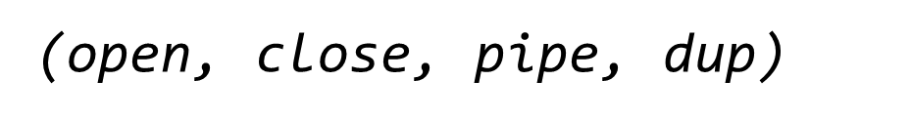
Pipe Example
What happens if we execute the following command?
$ cat names.txt | sort
And how about the following commands?
$ mkfifo named.pipe
$ echo “Hello World!” > named.pipe
$ cat named.pipe

Slide 64
Pipe Example (open, close, pipe, dup)
int open(const char *pathname, int flags)
Opens the file specified by pathname
int close(int fd)
Closes the specified file descriptor fd
int pipe(int pipefd[2])
Creates a pipe with two fds for the ends of the pipe
int dup(int oldfd)
Creates a copy of the oldfd file descriptor using the lowest-numbered unused file descriptor for the copy

Slide 65
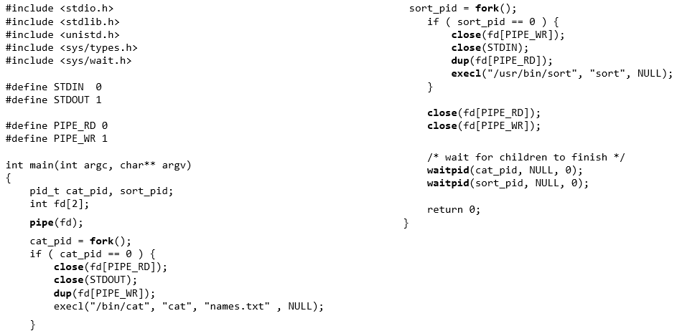
Pipe Example

Slide 66
Modern Operating Systems
Fifth Edition
End of Introduction
Copyright © 2023, 2014, 2008 Pearson Education, Inc. All Rights Reserved

